Slide 1




Deep Stable Representation Learning on Electronic Health Records
Presenter: Yingtao Luo (PhD student at Carnegie Mellon University)
Authors: Yingtao Luo, Zhaocheng Liu, Qiang Liu
Notes:
Hello everyone. It is my pleasure to present our work, deep stable representation learning on electronic health records here. My name is Yingtao.

Slide 2
Diagnoses Prediction based on EHR
Electronic Health Records (EHR) with diagnosis and procedure sequences.
ICD-9 codes denote different diagnoses and procedures.
Can we make a prediction?
3rd Diagnosis
Examples of diagnoses:
997.1: Cardiac complications
440.0: Atherosclerosis of aorta
395.0: Angioplasty Of Other Non-Coronary Vessel
381.8: Endarterectomy, Lower Limb Arteries
1st Diagnosis
2nd Diagnosis
“If: 4th Diagnosis”
99812
436
43320
4019
56983
56089
49121
???
???
???
9971
4400
2017
3950
3818
9904
0044
2018
4573
311
4621
5472
3323
2019
2020
3603
3606
2021
Timeline
Examples of procedures:
01.2 (Craniotomy and craniectomy)
55.23 (Closed renal biopsy)
36.03 (Open Chest Coronary Artery Angioplasty)
Procedure codes can also refer to the medication.
3rd Procedure
1st Procedure
2nd Procedure
Notes:
The problem we are considering here is the diagnoses prediction based on electronic health records, which contain the historical diagnosis and procedure sequences of patients. Each diagnosis is represented by an ICD-9 diagnosis code and each procedure is also denoted by an ICD-9 procedure code. The diagnosis code is mostly classified by the first three numbers in the code while the procedure code is mostly classified by the first two numbers in the code. The problem here is whether we can leverage the historical information and potentially the demographical information of patients to make future prediction of diagnosis as a warning indicator.

Slide 3
Motivation
In the US alone, nearly 96% of hospitals had a digital electronic health records (EHR) in 2015.
Machine learning still largely underused for healthcare problems, since lives are at stake.
To make machine learning models more acceptable to clinical conditions and physicians:
How to improve the causality while learning EHR data?
2. How to make out-of-distribution generalization for EHR learning?
Most machine learning models are known as unstable in making prediction,
due to spurious correlations between core features and background features.
<Dog images containing grass background> – <Diabetes accompanied by insulin treatment>
Notes:
Electronic health records, or EHR, have been widely used in this decade. There have been many deep learning attempts for understanding the patterns hidden in EHR, such as what is the stage of diseases, what is the probability for patients to be readmitted to hospitals, etc. The performance of deep learning outperforms many traditional statistical methods, but at least two problems are still not fully resolved.
First, it is hard to guarantee the causality in deep learning models, since most of the training datasets contain spurious correlations that can be harmful for causality. A well-known example in computer vision is that, if we always feed dog images with grass background to a machine learning model, whenever there is an image with grass, the model will simply predict it as a dog even there is no dog in it. In electronic health records, a similar example is that if we always feed diabetes diagnoses with insulin treatment to the model, the model might learn from the spurious relationship between insulin and diabetes complications such as puffiness. If a patient with diabetes is not treated with insulin, the model will not be that confident to predict diabetes complications.
Second, how to make out-of-distribution generalization for electronic health records is rarely discussed.

Slide 4
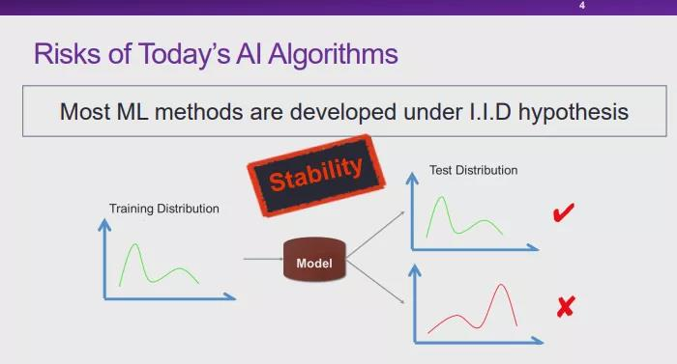
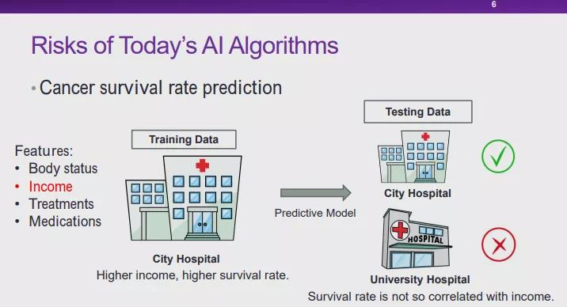
Out-Of-Distribution Generalization
Training and test distributions are not independent and identically distributed.
Most methods (domain adaption, causal transfer learning, etc.) need test distribution.
We are interested the generalization without knowing test distribution a priori.
From the slides of https://mp.weixin.qq.com/s/uvl89ri39I2Xzm5urr62ZA
Notes:
Most machine learning methods are developed under the IID hypothesis, but in the real world the training dataset is often biased due to the data collection restrictions and other factors. For example, the training data collected from city hospitals may not apply to university hospitals due their difference in patient demography.
In literature, there are many works that discuss domain adaption and out-of-distribution generalization, but many of them require the test distribution knowledge, which is not always available to us. Therefore, we are interested in developing methods that can improve generalization without knowing test distribution a priori.

Slide 5
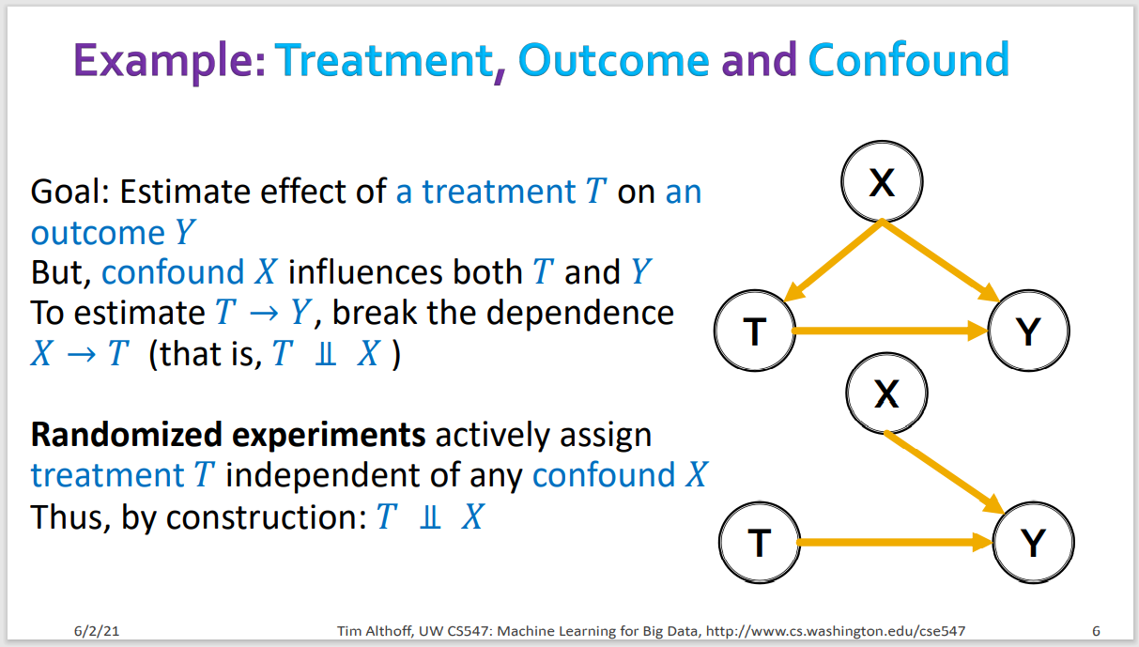
Backgrounds on Causal Inference
Notes:
In the past, there are also literature in leveraging causal inference for the machine learning models. The basic concept to ensure causality is to break the dependence between confounder and treatment, so we can simulate the randomized experiments. In this way, the estimation of treatment can be independent from covariates.

Slide 6
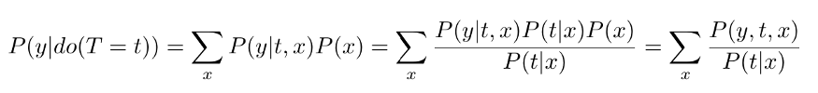

Challenges for counterfactual inference
1. Conditional Independence Assumption (CIA) and Ignorability
$(Y_{0}, Y_{1})⊥T | X=x$
2. Estimation of Propensity for Sample Weighting
Treatment identification: hard to distinguish treatment from covariates.
Propensity estimation inaccuracy: too many “T”s to estimate with limited data.
Notes:
One of the most famous approaches in causal inference to do so is the propensity score estimation. The basic idea is to reweight data samples to achieve the balance between treatment and covariates, which can effectively remove data bias. And usually that requires some assumptions such as the ignorability assumption.
However, in our case, we do not know whether the past procedures or the past diagnoses has the causal impact on future diagnosis prediction. Also, because we are discussing sequential EHR data, the combination of various ICD-9 codes in a sequential leads to an exponentially growing space. It is very hard to accurately estimate the propensity of each combination in this enormously large space with limited data.

Slide 7
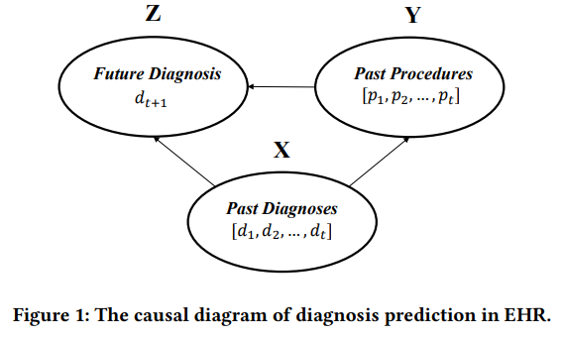
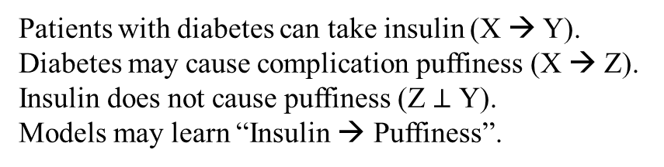
Causal Diagram on EHR
In this case, Y → Z would be spurious.
Here, X, Y, Z only denote variables.
Z
Y
Puffiness
?
Insulin
X
Diabetes
Patients with diabetes can take insulin (X → Y).
Diabetes may cause complication puffiness (X → Z).
Insulin does not cause puffiness (Z $⊥$ Y).
Models may learn “Insulin → Puffiness”.
Notes:
Therefore, we are considering a different approach that simply decorrelates the dependency between each feature, so obviously we can ensure causality without distinguishing the difference between covariates and treatment.
An example here is that patients with diabetes can take insulin as a cure and diabetes may can complications. If patients can all get insulin in the training data, models are likely to learn that the co-existence of diabetes and insulin causes diabetes complication.

Slide 8
Causal Diagram on EHR
Spurious Y → Z cannot generalize.
Z
Y
Puffiness
?
Diet
X
Diabetes
No Insurance
X → Z is causal and stable in various environments.
When X → Y change (distribution shift),
statistical models may not generalize well.
Notes:
However, for regions and people where insulin is a scarce resource, or for people without insurance, they are likely to be treated differently: for example, diet control is also a way to control the diabetes. In this way, the model trained on the co-existence of diabetes and insulin may not work. The core reason is that, the relationship between Y and Z is not causal and stable across different environments. Whenever the spurious relationship between X and Y changes, the model cannot generalize, despite that in real practice such distribution shift is very common.

Slide 9
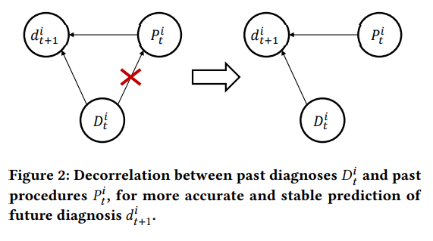
Stable Learning on EHR
Spurious Y → Z will be removed.
Z
Y
Puffiness
Insulin
X
Diabetes
Causal inference requires the conditional covariance between Treatment and Covariates to be zero. Here, X and Y shouldn’t be correlated to remove spurious relation.
Notes:
Therefore, if we can decorrelate the dependency between diabetes and insulin, we can ensure causality even without knowing which one has a causal relationship to the diabetes complication.

Slide 10
Stable Learning on EHR
Stable Learning aims at removing spurious relations and make stable prediction across distributions.
Q: How to measure conditional covariances between diagnoses and procedures?
A: Hilbert Schmidt Independence Criterion (HSIC) [1,2].
Q: How to minimize conditional covariances during/before model training?
A: Sample weighting (just like inverse propensity weighting).
[1] Daniel Greenfeld and Uri Shalit. 2020. Robust learning with the hilbert-schmidt independence criterion. In ICML. 3759–3768.
[2] Arthur Gretton, Kenji Fukumizu, Choon Hui Teo, Le Song, Bernhard Schölkopf, Alexander J Smola, et al. 2007. A kernel statistical test of independence.. In NeurIPS. 585–592.
Notes:
The way we perform such decorrelation is by first measuring the Hilbert Schmidt Independence Criterion, abbreviated as HSIC here. This criterion measures the difference between two distributions nonlinearly. If we can reduce HSIC during training through sample weighting, we will be able to minimize the conditional covariance required by causal inference theory.

Slide 11
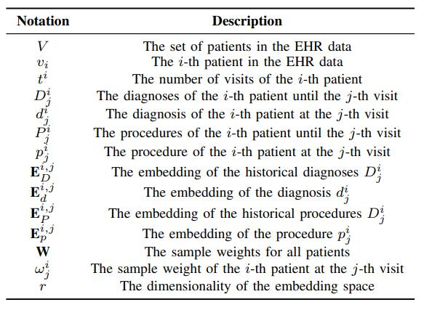
Notations and Descriptions

Slide 12
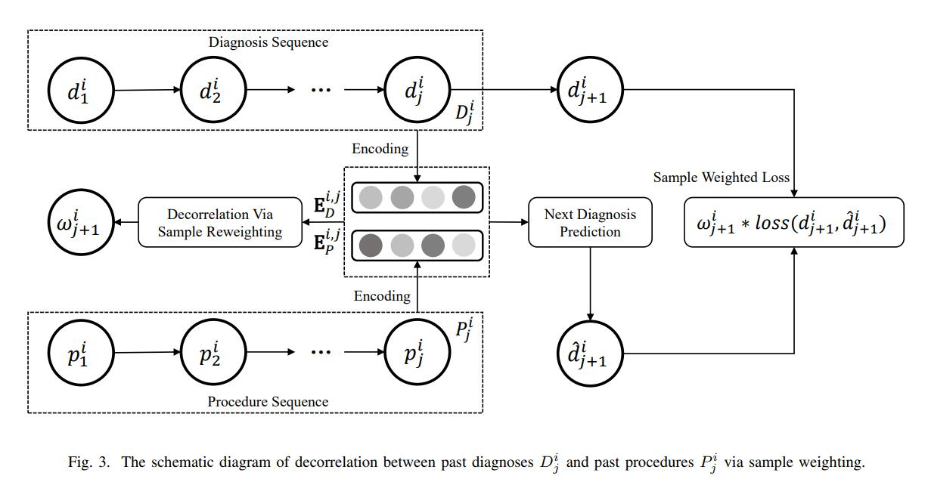
Causal Health Embedding (CHE)
Notes:
Overall, our method, the causal health embedding, simply calculates the HSIC from the encoded diagnosis sequence and procedure sequence and try to minimize HSIC by assigning individual weights to each patients. Then, the weights are assigned to the loss function to guide the model optimization.

Slide 13
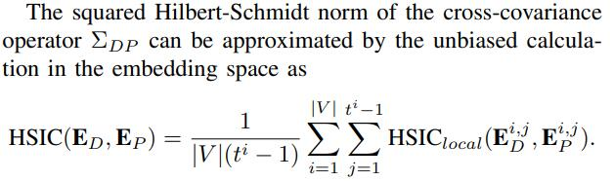
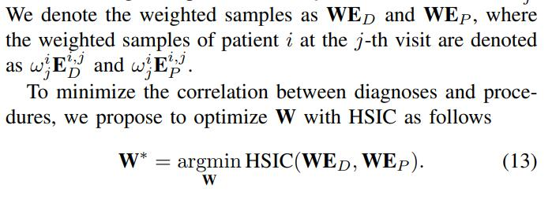
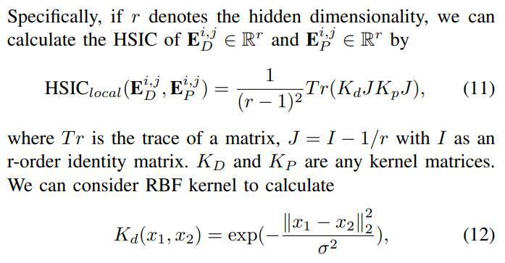
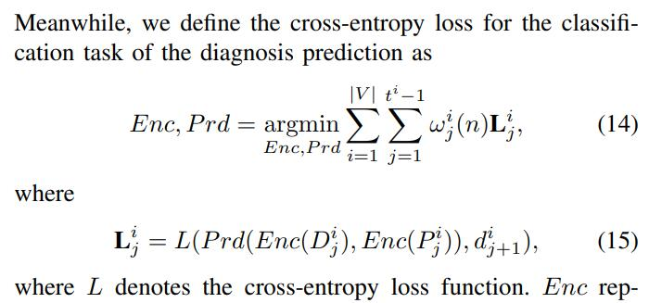
Algorithm Details
Notes:
In more details, when we calculate the overall HSIC, we sum up the local HSIC of each visit of each patient. We use kernel trick here to accelerate the calculation of HSIC. Basically, the minimization of HSIC to obtain sample weights and the minimization of weighted loss function are iteratively performed.

Slide 14
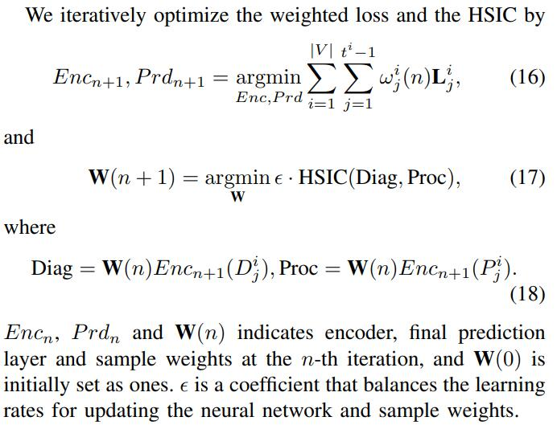
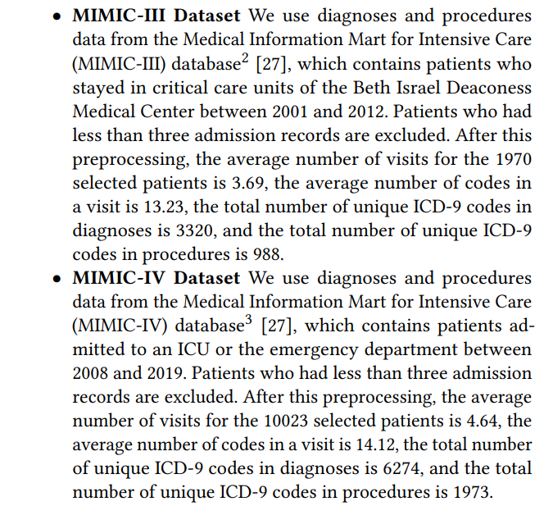
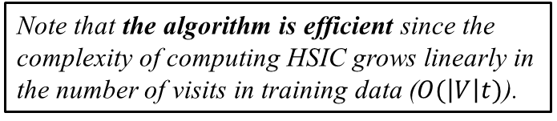
Algorithm and Datasets
Note that the algorithm is efficient since the complexity of computing HSIC grows linearly in the number of visits in training data ($O(\left|V\right|t)$).
Notes:
We also set a hyperparameter \epsilon here in front of the HSIC as a scaling factor, which controls how important we regard the minimization of HSIC and its optimization speed.
To sum up, our approach does not need to distinguish between confounders and treatments, since we simply decorrelates all the them.
Our approach also bypasses the inaccuracy challenge in the counterfactual learning (e.g., inverse propensity-based methods) to estimate the propensity score from limited data. Instead of having an exponentially growing space to estimate, our method only calculates HSIC between diagnoses and procedures, which only grows linearly in the number of total hospital visits.
Another advantage of our method is the computational efficiency. The complexity of computing HSIC grows linearly in the number of visits in the training data, which is acceptable to the original model training process.
The datasets we use in the experiments are MIMIC-III and MIMIC-IV datasets. These datasets are frequently used by many papers in the literature; hence, these datasets will be representative for comparison.

Slide 15
Data splitting for ID and OOD problem
Two types of experiment: In-Distribution (ID) and Out-Of-Distribution (OOD) experiments.
1. ID: We randomly divide the dataset into the train, validation and test set in a 0.75:0.1:0.15 ratio.
2. OOD: Considering different insurance types (such as Medicare, Medicaid and Private), we divide train and test data by the type of insurances. Here, we divide the Medicare data as train and validation set in a 0.7:0.3 ratio and use the Private/Other data as the test set.
Evaluation metrics: Topk Accuracy and NDCG (k=10, 20).
Notes:
We consider two kinds of experiments. One is the in-distribution and the other is the out-of-distribution. Remember when we discuss about the example of dog images with grass background. If a model is able to learn from core features of the dog independently without any confounders like the grass, the model will be encouraged to solely rely on the dog instead of the background, since the spurious relationship between dog and grass is removed. If the model is asked to do tasks for dog images with snow background, we will expect it to perform well.
In this case, we expect to our model, which removes the spurious relationship between diagnoses and procedure, to improve out-of-distribution generalization performance of machine learning models.

Slide 16
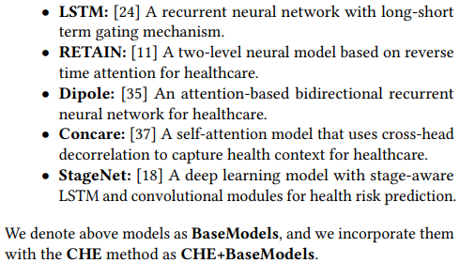
Baselines on EHR
We use Permutation Weighting (a binary inverse propensity weighting) as counterfactual learning. They are denoted as PW+BaseModels.
Notes:
The machine learning models we consider include LSTM, RETAIN, Dipole, Concare, and StageNet. We will see if our method works on those baselines.
We also consider a counterfactual learning method that performs binary inverse propensity weighting on EHR to estimate the propensity of different patient history.
The results of baselines, CHE+baselines, and PW+baselines we are going to show are based on each one’s best performance tuning the hyperparameters such as learning rate, hidden neural dimension, etc.

Slide 17
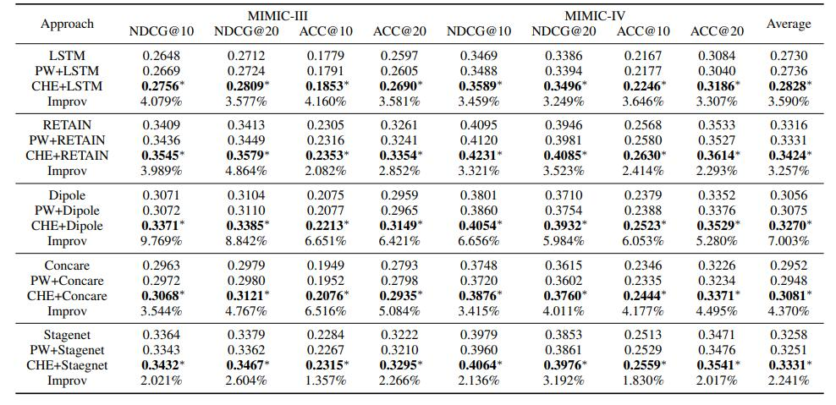
ID experiment
Notes:
The ID experiments show some that our method has some minor improvements on average, about 3-4%. On the contrary, the counterfactual learning does not work well. This is not surprising, since the traditional way to perform inverse propensity weighting requires a large space to estimate, which is too difficult.

Slide 18
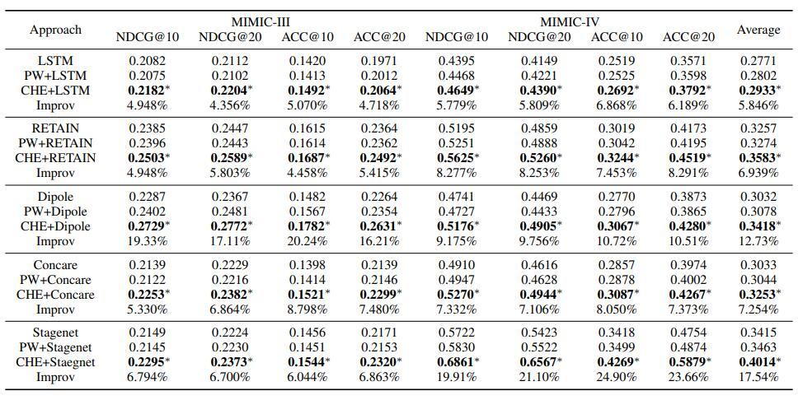
OOD experiment
Notes:
In the OOD experiment, we find that our method can improve the performance of baselines significantly, about 8-9% on average.

Slide 19
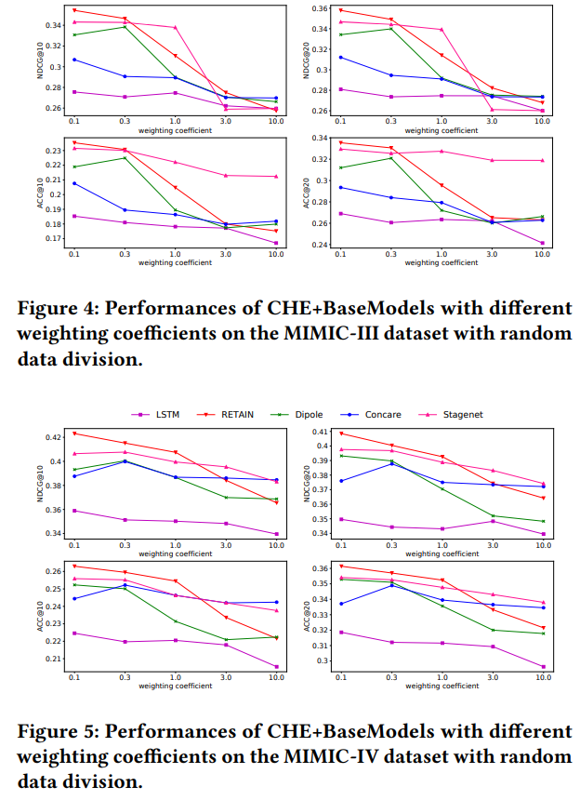
Performances with different weighting coefficients
Notes:
In the hyperparameter sensitivity experiment, we find that our method is quite sensitive to the change of a core hyperparameter – the weighting coefficient, which can a limitation to apply in real practice. An observation is that the weighting coefficient should not be too large.

Slide 20
Performances with different weighting coefficients

Slide 21
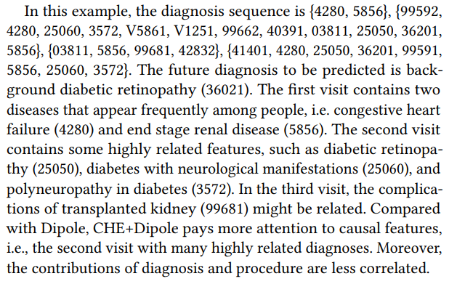
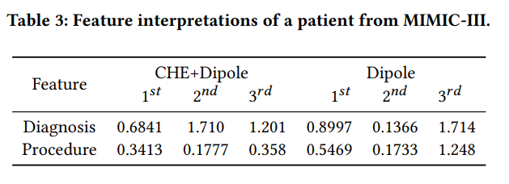
Interpreting Results on EHR
Notes:
We also visualize the feature interpretations of a patient diagnosed with diabetes. The feature interpretation is calculated by the gradient multiplying the feature embedding as the contribution to the final output.
The first hospital visit of this patient contains two common diseases. The second hospital visit of this patient contains highly related features such as diabetic retinopathy, polyneuropathy in diabetes, etc. The third visit contains complications of transplanted kidney, which might be related if not highly related. For a model powered by causality, we expect the model to weigh more on the second visit to give the prediction of diabetes complication. And in experiments, we do find that our CHE+Dipole weighs more on the second visit while Dipole itself does not weigh too much on the second visit.

Slide 22
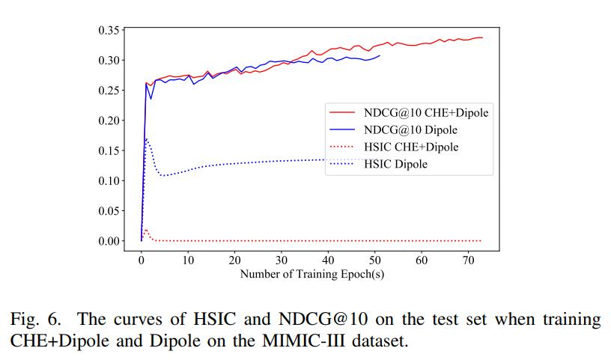
Interpreting Results on EHR
Notes:
We also visualize both the NDCG curve and the HSIC curve in the number of training epochs on the test set. We observe that the minimization of HSIC is highly related to the consistent increase of NDCG in more training steps. This is a clue that HSIC does help the model training.

Slide 23
Conclusion
In this work, we focus on the stable learning of EHR learning for causality and OOD generalization.
We propose an efficient algorithm to remove spurious correlation between diagnoses and procedures.
CHE can significantly improve the performances of diagnosis prediction models, especially in OOD.
CHE presents more causal predictions than baselines. The HSIC and model performance is correlated.
Societal impact: Better balance between performance and trustworthiness. A new paradigm of using machine learning models for processing EHR and other related health tasks.

Slide 24
Difference between counterfactual & CHE
Counterfactual learning aims to mimic Randomized Controlled Test. A popular way to achieve so is the inverse propensity weighting that assigns treated/controlled samples different weights (based on the probability of treatment in the population) to remove the bias of being treated or not.
The problem of identifying treatment to achieve CIA. For different patients, the treatment (the causation for future diagnosis) can either be past diagnoses or procedures. Sometimes there is a bad procedure, sometimes it is because the disease is hard to cure that leads to readmission.
A common way is to identify observed data as treatment and unobserved data (can be obtained by generating false data) as control, by which we can mainly remove the sample selection bias.
The problem of propensity estimation inaccuracy. Unobserved data distribution is unknown and the combination of various ICD-9 codes in a sequence grows exponentially in the number of visits. It is expected that the propensity estimation based on this can hardly be accurate.

Slide 25
Difference between counterfactual & CHE
Stable learning bypasses the identification challenge in the counterfactual learning. Note that stable learning does not require to identify treatment and covariates, since it removes the dependencies between diagnoses and procedures, regardless of which one is treatment.
Both stable learning and counterfactual learning want to remove the spurious relationships between treatment and covariates (confounders), so the confounders will not affect causal prediction.
Stable learning bypasses the inaccuracy challenge in the counterfactual learning (e.g., inverse propensity-based methods) to estimate the propensity score from limited data. Instead of having an exponentially growing space to estimate, stable learning only calculates HSIC between diagnoses and procedures, which only grows linearly in the number of visits.
It is not a guarantee that removing spurious relationships by stable learning is always accurate. We have to empirically verify its effectiveness, since it is hard to analyze theory in non-linear models.

